Slide 1


AI Resume Analyzer
RESUMIND
Smart, honest feedback for your dream job — ATS score, Europass CV and cover letter
Scan to try it live
CSE4204 Mobile Computing Lab · Team CSE4204-8A-T05 · Section 8A
Team Leader: Mahammad Hasan (11220320828)
Shanawaz Sakib (11220320916) · Ashikur Rahman Himel (11220320833) · Rasel Ratul (11220320827)
GitHub: github.com/mahamud894/AI_Resume_Analyzer
Supervisor: Md. Riaz Mahmud, Assistant Professor, Dept. of CSE, NUBTK
ai-resume-analyzer-psi-lime.vercel.app
Notes:
Good morning. We are team CSE4204-8A-T05 and our project is RESUMIND, an AI resume analyzer. It checks a resume against a real job, explains what to improve, rewrites it in the European Europass format and writes a matching cover letter. The QR code opens the live system.

Slide 2




Good CVs are rejected before a human reads them
Filtered by ATS
No feedback
Unknown standard
Time-consuming
Applicant Tracking Systems reject resumes with missing keywords, weak verbs or unclear structure — automatically.
Applicants get repeated rejections without knowing what to fix.
International employers expect a Europass CV (MM/YYYY dates, CEFR, EQF) that most graduates were never taught.
A personalised cover letter for every application takes hours, so most people send generic ones.
Existing tools fall short: Jobscan and Resume Worded are paid after a few scans and match keywords without context; Reactive Resume is only a builder with no AI analysis. None combine analysis, a Europass rewrite and a cover letter for the same job.
Notes:
Most companies use ATS software. A capable graduate can be rejected only because a keyword is missing. They never learn why. Europe expects the Europass format, and writing a letter for each job takes too long. Existing tools are paid or only solve one part.

Slide 3








Objectives
O1
O2
O3
O4
Secure accounts
Document vault
AI ATS analysis
Europass rewrite
bcrypt + JWT, Google Sign-In
PDFs and history in MongoDB
Score + 5 categories with tips
Fix every tip, never invent facts
O5
O6
O7
O8
Before / after
Cover letter
Any device
Quality & deployment
Measure the gain with a new score
One page, tied to the same job
Responsive, mobile-first UI
48 tests, CI, live on the web
Notes:
We set eight objectives in our proposal and all eight are met. Security, a document vault, AI analysis, a Europass rewrite, a way to measure improvement, a cover letter, mobile support, and tested deployment.

Slide 4

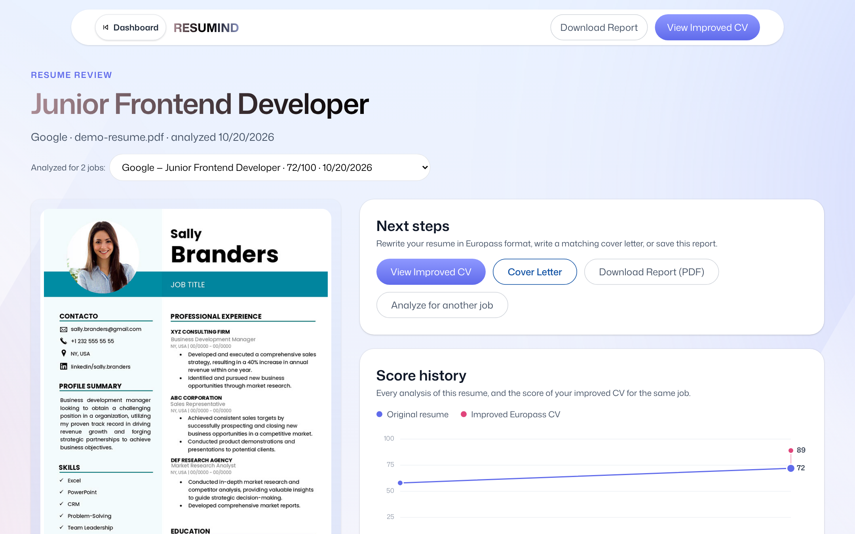
One flow from upload to cover letter
1. Upload
2. Analyse
3. Europass CV
4. Before / after
5. Cover letter
PDF + job title and description
Overall score, ATS, tone, content, structure, skills
Rewrite, inline edit, change list, PDF
Same job, new score, history chart
Formal or modern, editable, PDF
Also included
History dashboard and printable report
Email/password and Google Sign-In
Change password, delete account
Phone, tablet and desktop layouts
Notes:
The user moves through five steps. Upload with the job, get the analysis, improve to Europass, measure the new score, and generate the letter. Everything is saved in the dashboard history.

Slide 5
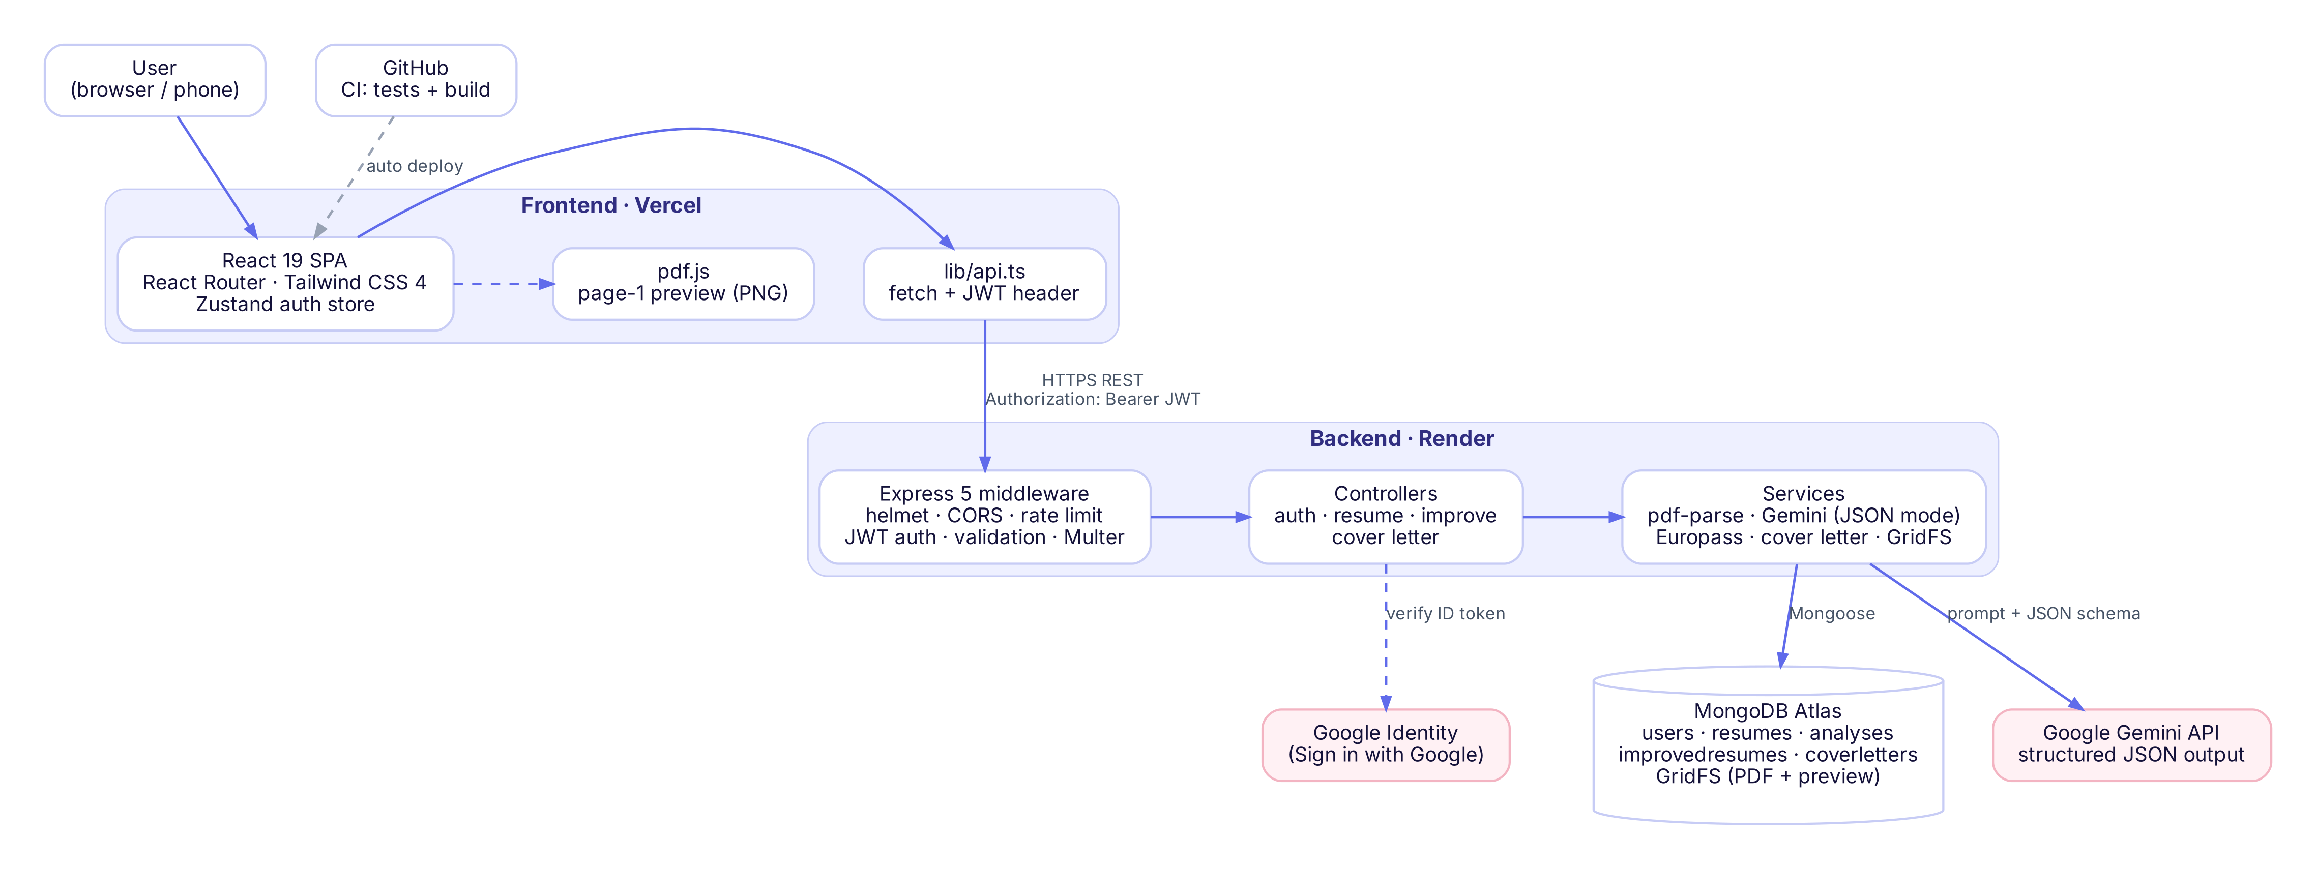
Architecture: three tiers, secrets only on the server
Frontend · Vercel
React 19, React Router 8, Tailwind CSS 4, Zustand, pdf.js
Backend · Render
Node.js, Express 5, Multer, pdf-parse, helmet, express-validator
Data & AI
MongoDB Atlas + GridFS, Google Gemini, Google Identity
Notes:
The React app runs in the browser and talks only to our Express API over HTTPS with a JWT. Only the API can reach MongoDB Atlas and Gemini, so the keys never leave the server. We started with Puter.js in the browser and replaced it with this backend to match the ERD and secure the AI key.

Slide 6
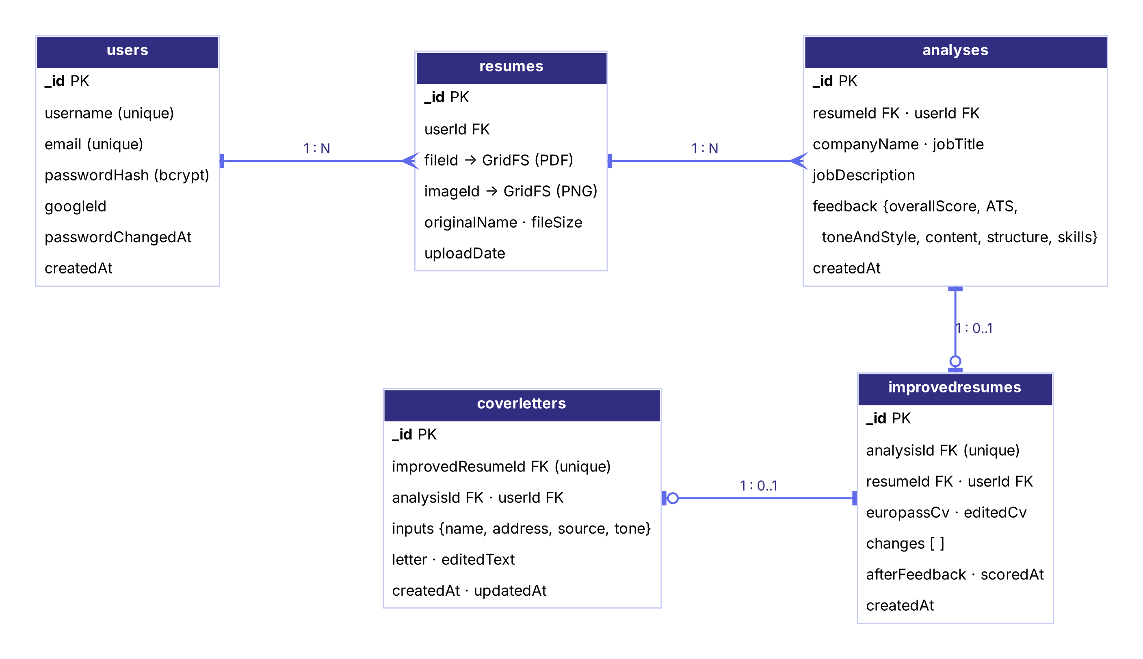
Database design
users 1–N resumes 1–N analyses 1–0..1 improvedresumes 1–0..1 coverletters
userId on every document — queries are always filtered by owner
Unique indexes: one CV per analysis, one letter per CV
Cascade delete for resume and account
AI version and user edits stored side by side
PDFs and previews in GridFS — safe across redeploys
Notes:
Five collections follow the ERD. Every document stores the owner, unique indexes enforce one improved CV per analysis and one letter per CV, and deleting cascades. Files are stored in GridFS because Render's disk is temporary.

Slide 7



AI workflow
pdf-parse
Prompt
Gemini
Retry
Normalise
Save
Extract text (422 if scanned)
Resume + job + rules
JSON mode + schema
Busy → wait 2 s, then 4 s
Clamp scores, drop bad tips
Analysis → result page
Analysis
Overall score + ATS, tone & style, content, structure, skills — each with good / improve tips
Europass rewrite
Every "improve" tip + job → Europass CV and a list of changes
Before / after
Improved CV → text, placeholders removed → same prompt, same job
Cover letter
AI writes opening, body, closing; code adds header, subject, salutation, sign-off
Notes:
Every AI feature uses the same service. Text is extracted, a prompt is built, Gemini answers in JSON mode with our schema, temporary errors are retried, and the result is validated before saving. Four features reuse this path.

Slide 8
Keeping the AI honest
3×
postCheck() in code fixes what the model gets wrong
AI wrote | After post-check
improved load time by 40% | by [Add a measurable result, e.g. X%]
November 30, 2024 | 11/2024
Current (ongoing degree) | Expected 08/2026
H.S.C, 4.67 | Higher Secondary Certificate (HSC), GPA 4.67 / 5.00, EQF 4
Religion, date of birth | removed (not part of Europass)
automatic retries when Gemini is busy
15/h
AI requests per user
0
invented numbers allowed in the CV
Placeholders show the user exactly what to fill in — the CV stays truthful.
Notes:
A language model can still invent things. So after Gemini answers, our code checks the CV: any number not in the original becomes a placeholder, dates become MM/YYYY, qualifications are written in full with EQF level, and private data is removed.

Slide 9




Authentication, security and API
bcrypt + JWT
Passwords 8–72 chars, hashed. Token valid 7 days; password change logs out other devices.
21 REST endpoints
Group | Endpoints
Auth (6) | register, login, google, me, password, delete
Resume (6) | upload, list, get, file, image, delete
AI (8) | analyze, improve, get/edit CV, score, cover letter get/create/edit
Health (1) | /api/health for Render
Google Sign-In
ID token verified on the server; only verified e-mails.
Hardening
helmet, CORS allow-list, validation on every input, 404 for other users' data.
Rate limits
20 auth requests / 15 min per IP; 15 AI requests / hour per user.
Authorization: Bearer <JWT> · JSON errors { message, details }
Notes:
Passwords are hashed with bcrypt and tokens are JWTs. Changing the password logs out other devices. Google tokens are verified on the server. Every input is validated and rate limits protect logins and the AI quota. The API has 21 endpoints, documented in our API documentation.

Slide 10


Testing and continuous integration
48
automated API tests, all passing in GitHub Actions
Vitest + Supertest
In-memory MongoDB
Gemini mocked
CI on every push
Real HTTP requests against the Express app
Fresh database every run; no real data touched
Fast, repeatable, no API key needed
Backend tests + frontend type check and build
Notes:
We have 48 automated tests. They send real HTTP requests, use a temporary in-memory MongoDB, and mock Gemini. GitHub Actions runs them on every push together with the frontend build, so a broken change never reaches the live site. We also did manual testing on phones and desktops.

Slide 11


Deployment: live on the web
Vercel Frontend · static SPA
https://ai-resume-analyzer-psi-lime.vercel.app
Render Backend · render.yaml Blueprint
resumind-api-3kpd.onrender.com
MongoDB Atlas Database + GridFS files
M0 cluster
Try it now
Secrets live only in .env and the Render / Vercel dashboards — never in Git.
GitHub Actions Tests before every deploy
github.com/mahamud894/AI_Resume_Analyzer
Notes:
The frontend is on Vercel, the backend on Render using our render.yaml, and data in MongoDB Atlas. Every push to main runs CI and redeploys both. Secrets are only in environment variables. Note that Render's free plan sleeps, so the first request can take about 50 seconds.

Slide 12
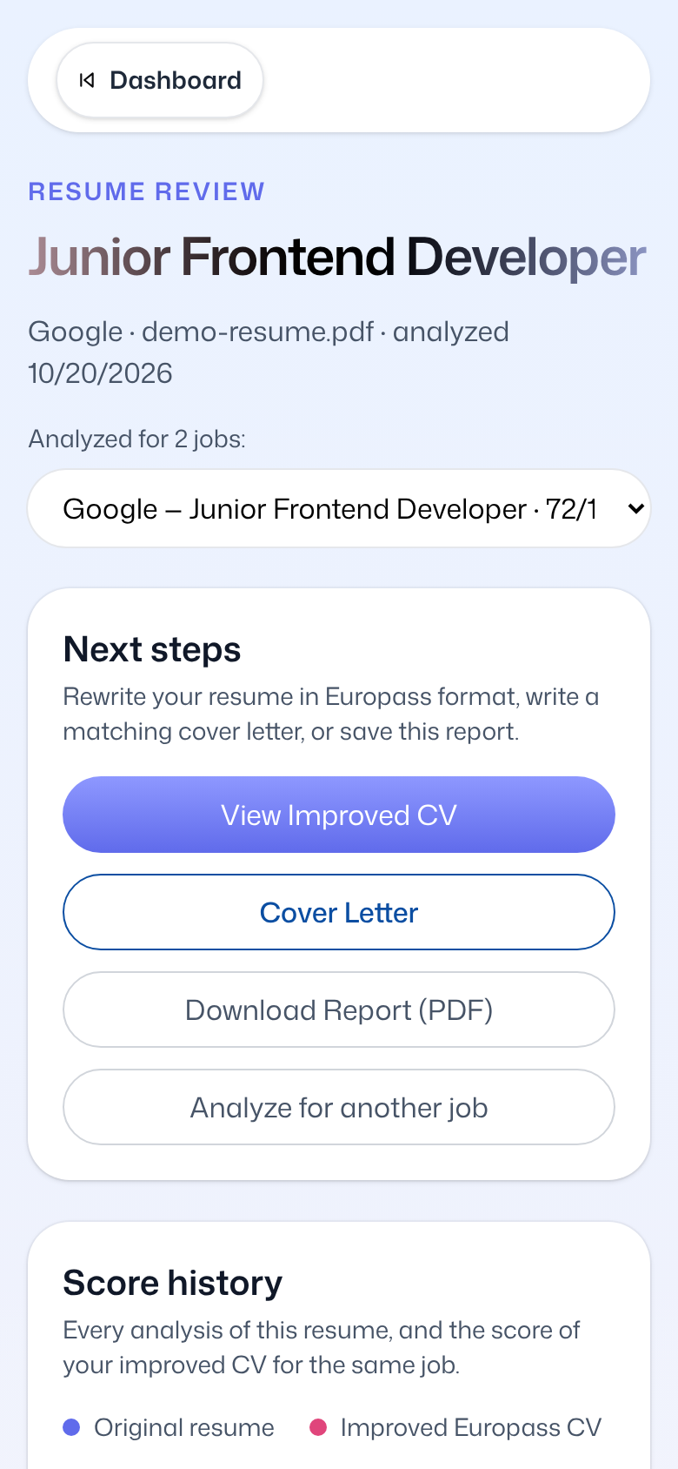
Live demonstration
1
Open the live site on laptop and phone
2
Sign up / Sign in with Google
3
Upload a resume for a real job
4
Read the scores and tips
5
Improve to Europass, edit a line
6
Score the improved CV
7
Generate and download the cover letter
8
Dashboard history + green CI
Notes:
Now we show the system live. Each member demonstrates the part they built: Ratul authentication, Sakib upload, analysis and Europass, Mahammad editing, scoring and the cover letter, Himel the dashboard and tests. Backup: if the network or Gemini fails, the next slide has screenshots of every step, and the demo account already contains a finished analysis.

Slide 13
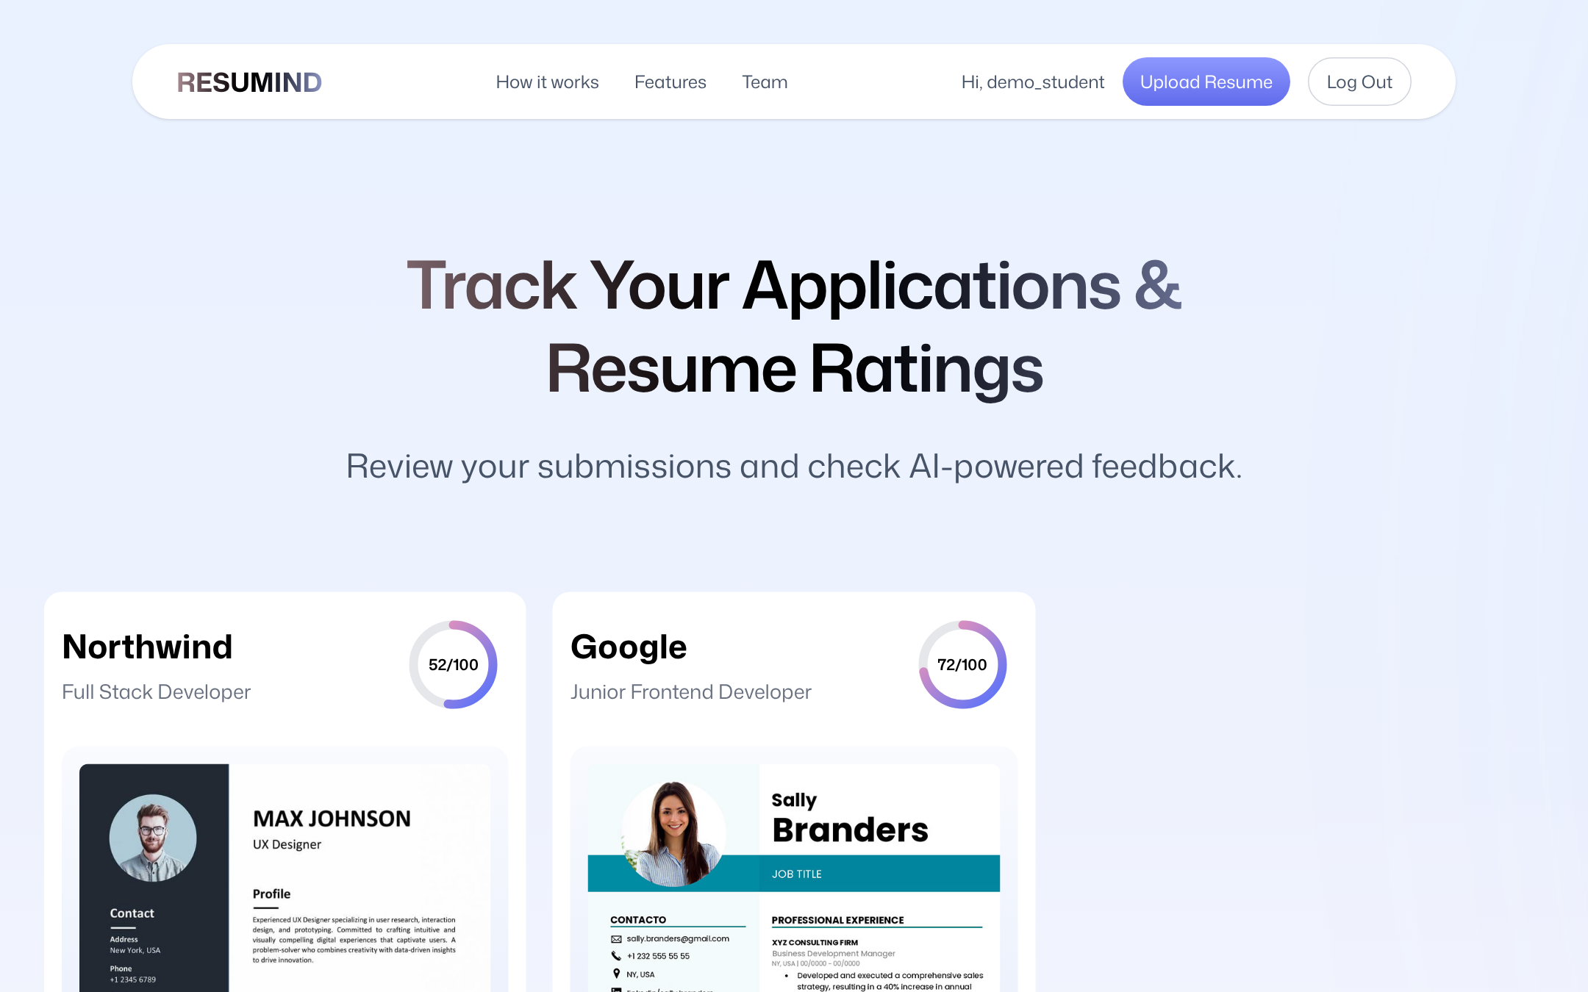
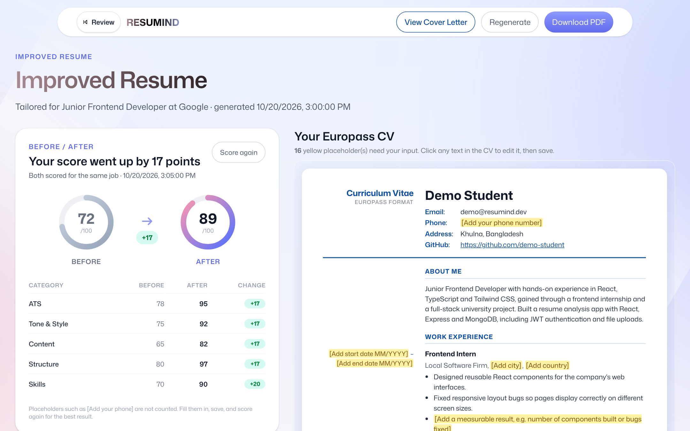
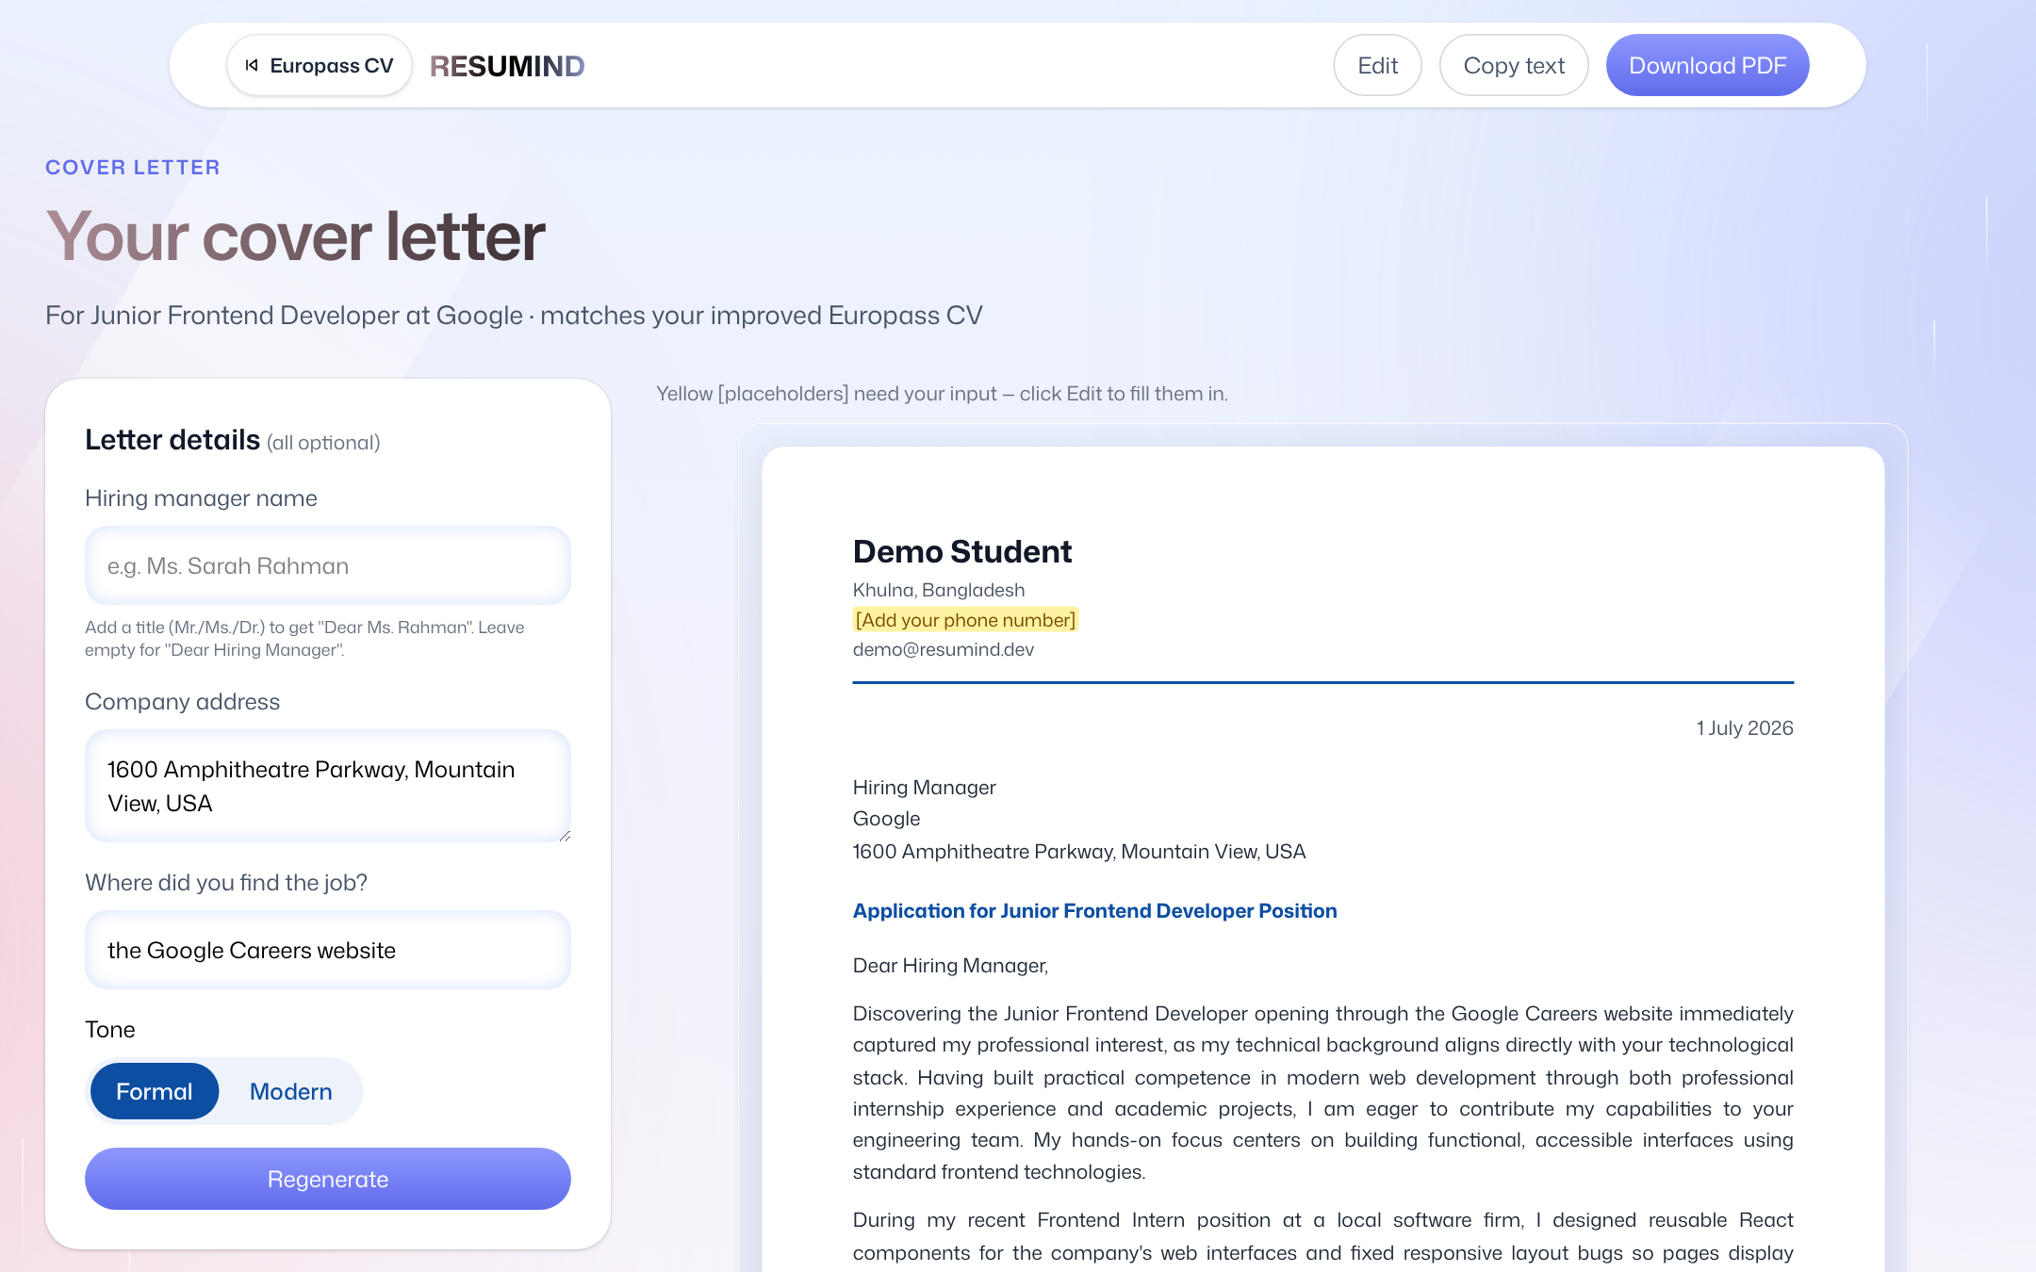
Screens (backup for the demo)
Dashboard
Analysis result
Europass CV
Cover letter
Notes:
Backup screenshots of the main screens in case the live demo cannot run.

Slide 14
Challenges and how we solved them
Inconsistent AI output
→ JSON mode + strict schema + validation in code
AI invented numbers and dates
→ Deterministic post-check with placeholders
Gemini "high demand" errors
→ Retries with back-off, clear messages
Files lost on redeploy
→ Moved storage to MongoDB GridFS
One rate limit for all users behind a proxy
→ TRUST_PROXY so each real IP counts
Document-heavy pages on phones
→ Mobile-first layout, A4 sheets that scale
Notes:
The biggest challenge was making the AI reliable and truthful; we solved it with schemas and post-checks. Others were busy errors, file storage on Render and the mobile layout.

Slide 15




Future improvements
OCR for scanned PDFs
Job link import
Interview practice
Read image-only resumes and DOCX files
Paste a LinkedIn or BDJobs link instead of the description
AI questions based on the CV and the job
Bangla support
Native mobile app
Recruiter mode
Interface and feedback in Bangla
React Native on the same REST API, push notifications
Rank many resumes against one job
Notes:
Next we would add OCR, job-link import, interview practice, Bangla, a native mobile app and a recruiter mode. The REST API already supports a mobile client.

Slide 16




Thank you — questions?
Mahammad Hasan
Shanawaz Sakib
Ashikur Rahman Himel
Rasel Ratul
11220320828
11220320916
11220320833
11220320827
Team Leader · Frontend + UI/UX
Core System Integration
Database & Quality
Backend Developer
Live: https://ai-resume-analyzer-psi-lime.vercel.app
Code: github.com/mahamud894/AI_Resume_Analyzer
Supervisor: Md. Riaz Mahmud, Assistant Professor, Dept. of CSE, NUBTK
Notes:
Thank you. Each of us can explain our own part: Mahammad the frontend and design, Sakib the AI integration, Himel the database and testing, and Ratul the backend and security. We are happy to take questions.

